Slide 1
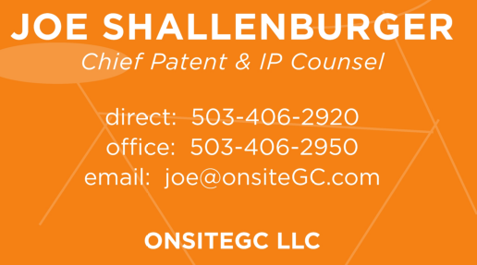
Oregon State Bar Corporate Counsel Section Fall 2014 CLE
IS BIG DATA GIVING
YOU A BIG HEADACHE?
Risk Reduction - Transactional, International and Liability Issues

Slide 2
Big Data: Risk Reduction
1. Contract & Transactional
2. Data Liability Issues
3. International Issues
4. Can Insurance Help?
5. Best Practices

Slide 3
Contract & Transactional-1
Review ALL Contracts that underlie a data transaction
Identify issues regarding disclosure of data and regulatory compliance
Information about warranties
Accuracy & Completeness of data
Compliance with Privacy policies & expectations
Indemnification
Protection against breaches and contract terms
IP Infringement
Customer issues & Confidentiality
Cross-indemnification only when makes sense
Breach, downtime, loss, recovery

Slide 4
Contract & Transactional-2
Service Levels
Scalability
Pricing & Licensing
Renewal
Who is responsible for breaches?
Request Tech E&O, plus Privacy/Network Coverage
Breach could occur without “wrongful act” being committed
Other Vendors that transport, touch, interact with your systems or sensitive information

Slide 5
Contract & Transactional-3
Provider’s right to subcontract? If so, Flow Down & regs.
Risks and costs fairly allocated
Termination
How does contract end?
What happens to the data?
Disengagement assistance
Can the data be combined or transferred to another platform?
Who is responsible for security of data after termination?

Slide 6
Contract & Transactional-4
Engage in careful contracting: preserve control, reduce risk of disclosure assign security obligations and enforcement costs
– Affirmatively deny consent to interception or disclosure of data conveyed by/through Cloud provider to governments or litigants
– Require notification of breach/disclosures/requests for data
– Deny access unless specifically authorized in advance or compelled by law (in which case notification is requested)
– Require maximum possible resistance to disclosure
– Determine access controls and encryption protocols

Slide 7
Data Liability Issues
Where will the data be stored and backed up?
Who can access it?
Adequate security controls and audits in place?
Absolute right to get the data back without conditions?
Can provider use or access the company’s data?
Do third parties have access to the data?
Control of Data: Does control change as data moves?
Disclosure and/or consent?
Privacy policies in place, agreed to and meet regulations?

Slide 8
Can Insurance Help-Yes
Whose insurance covers damages & stat. requirements?
Cyber Policy coverage examples
Privacy Expenses
Network Security and Internet Media Liability
Network Business Interruption and Restoration Costs
Cyber Extortion
Liability Coverage: Privacy, Network Security, Media, IP & Content Liability, Technology Services
Data Breach Expense: PR, investigation, notification, credit monitoring costs, fines, penalties
Direct Coverage: Revenue Loss, Reconstruction, Extortion Costs

Slide 9
International Issues
DATA MAY NOT BE ALLOWED TO CROSS BORDERS!
Not for storage, Not for analysis
Not for sharing with the Main Office or Subsidiaries
EU Requirements-Directives 95/46/EC and Directive 2002/58/EC
Must maintain accuracy of the data
Destroy the data when specific purpose is over
Give subjects access to the data
Disclose with whom the data is shared
Keep data secure from unlawful processing
New regulations being considered

Slide 10
Best Practices
Maintain a Risk Transfer Instrument
Have a Background Screening Program for new hires & vendors
Pre-Arrange a Breach Service Provider, Outside Counsel and PR Advisor with all specializing in Breach Crisis Management
Encrypt everything
Develop an Incident Response Plan with Internal Staff, Outside Counsel, PR Advisor, Breach Service Provider
Conduct annual Risk Assessments and Tabletop Exercises.
Hold an internal “Privacy Summit” to identify vulnerabilities
Compliance and Privacy, HR, Legal, IT, C-level representation (CFO), Physical Security / Facilities – “Technology, Processes and People.”
Stay current with state disclosure laws, federal regulations, foreign requirements and updates

Slide 11
10 Steps to Protect Company
Know what personal information company has
Know where the personal information is
Understand how the data is managed
Determine retention requirements
Develop policies
Involve key players
Get rid of unused or unnecessary personal information
Train employees regarding privacy policy and personal info
Audit Policy compliance
Conduct a risk assessment

Slide 12
Summary: Risk Reduction
1. Contract & Transactional
3. Data Liability Issues
4. International Issues
5. Can Insurance Help?
6. Best Practices

Slide 13
Oregon State Bar Corporate Counsel Section Fall 2014 CLE
QUESTIONS
Now or Later
Risk Reduction - Transactional, International and Liability Issues

